Slide 1
Mitosis, Meiosis & Chromosomal Disorders
EQ1: What is the difference between Mitosis and Meiosis?
EQ2: What is the difference between haploid and diploid?

Slide 2
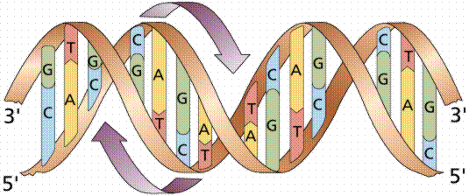
DNA is the molecule that transfers hereditary information from one cell to the next.
This is a model of the double helix shape of DNA.
Notes:
2

Slide 3
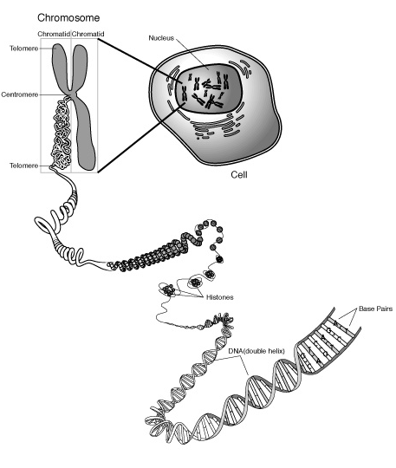
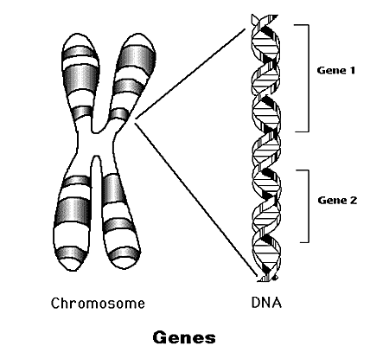
When a cell is dividing, DNA winds up tightly and forms chromosomes in the nucleus of the cell. A Copy of DNA is needed in all cells.
A specific portion of the DNA is called a gene, which has 1 piece of genetic information. Ex. Hair color is a gene.
The genes are contained within the chromosome.
Notes:
3

Slide 4
Fill in your diagram!

Slide 5
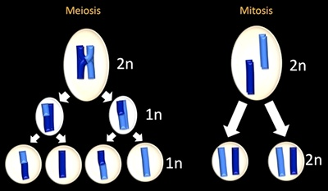
Mitosis & Meiosis
Mitosis purpose: Copy cell & DNA inside, ex. heal wounds
Meiosis purpose: Make genetically unique gametes that can combine with other parent gamete ex. Make babies

Slide 6
DRAW:
MITOSIS
Somatic Cell
When somatic (body) cells reproduce themselves the process is called MITOSIS.
2N
Main purposes of mitosis:
Growth
Repair
Asexual reproduction (bacteria)
2N
2N
Daughter Cells
All cells made by Mitosis are diploid, containing 2 copies of each chromosome (2N).
Mitosis leads to the production of two “daughter cells”.
Each daughter cell has the same number of chromosomes as the parent cell.

Slide 7
MEIOSIS
DRAW:
Each cell made by Meiosis contains only 1 copy of each chromosome (n).
When gamete (sperm or egg) cells reproduce themselves the process is called MEIOSIS. Meiosis reduces chromosome # in half.
Making Gamete Cells
2N
During meiosis, a single diploid cell divides and produces FOUR genetically different haploid cells.
N
N
In Meiosis crossing over occurs, where the chromosomes next to each other (homologous chromosomes) swap genes, this increases genetic variety in the potential offspring.
N
N

Slide 8
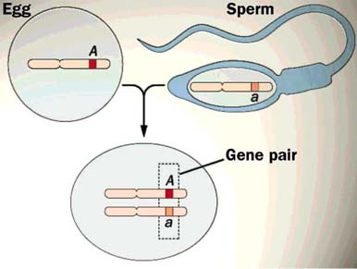
Gametes (n)
Made by Meiosis
Somatic Cells (2n)
Reproduce (clone) through Mitosis

Slide 9
In animals…
Somatic cells (cells of the body) are diploid. This means that each cell has two chromosomes of each type. They are in PAIRS. One from mom and one from dad. These are the cells used to make karyotypes. Made through MITOSIS.
Biologists use “2N” to symbolize diploid.
Gamete cells (egg, sperm) are haploid. This means that each cell has only ONE of each type of chromosome. Why? Made through MEIOSIS.
Biologists use “N” to symbolize haploid.

Slide 10
Mitosis or Meiosis???
1. Asexual Reproduction? ____
2. Results in 2 identical cells? ____
3. Results in 4 non-identical cells? ____
4. Produces gametes? _____
5. Results in variation? _____
6. Results in haploid cells? _____
7. Used for growth and repair? _____
8. Skin cells? _____
9. Sperm cells? _____
10. Makes 2N cells? _____

Slide 11
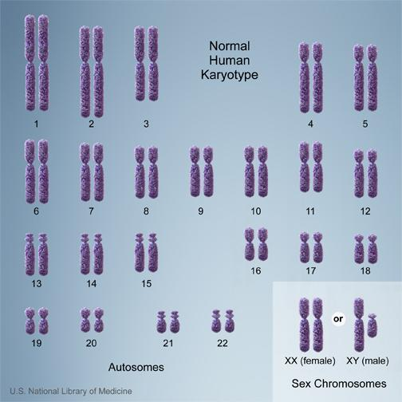
Mom
Dad
Sex Chromosomes: A single pair of chromosomes that determines the gender of the organism. Always put last, pair #23.
-Female = XX
-Male =XY
-Do NOT always match by size- XY!
Autosomes: All other chromosomes not involved in gender determination. Pairs #1-22, Put from largest to smallest.
-Matched by same size, like socks!
M
D
M
D
M
D

Slide 12
Arts & Crafts: Karyotyping
No, the chromosomes in your cells are not usually neatly paired up from 1 to 23. First, scientists have to stain the cell and view it with a powerful microscope. They then take a photograph of the chromosomes in the cell, print it out, cut out the chromosomes and find the matching pairs by same size. They then line them up from largest to smallest with the XX or XY at the end.

Slide 13
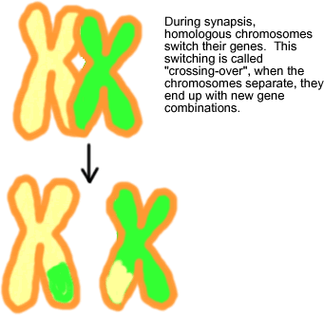
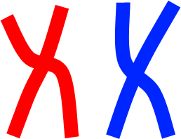
Meiosis: Crossing Over: Homologous Chromosomes swap (switch) some genes during MEIOSIS only. This creates variety in the gametes.
This is why kids who have the same two parents don’t have to look identical, or even alike. Or, conversely, why two siblings might look exactly like their sibling- if they had the same cross-overs.

Slide 14
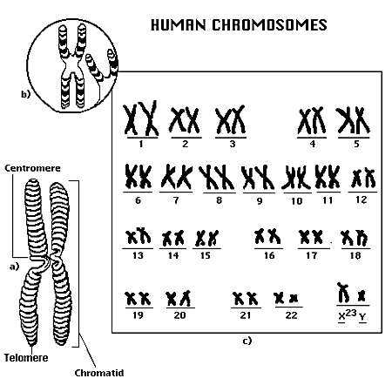
A karyotype is a picture showing the arrangement of a full set of human chromosomes.
We are homologous pair #5!
We are the sex chromosomes and we determine the gender
-Humans have 46 (23 pairs- half from mom, half from dad) chromosomes
-Each pair is called “homologous,” meaning “same” genes
Notes:
14

Slide 15
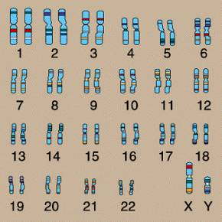
Practice
Is this karyotype from a male or female human?

Slide 16
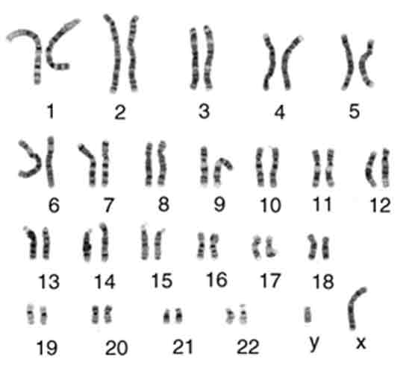
Practice
Is this karyotype from a male or female human?

Slide 17
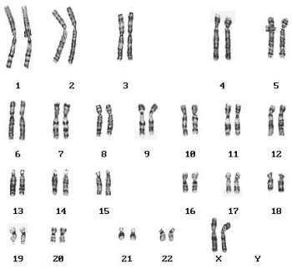
Practice
Is this karyotype from a male or female human?

Slide 18
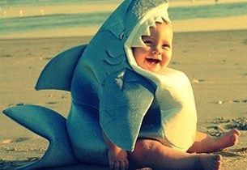
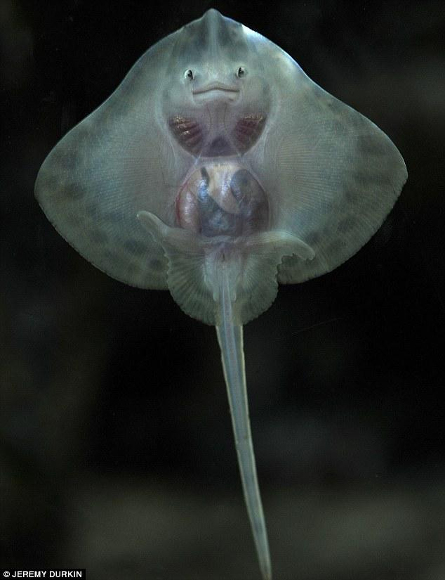
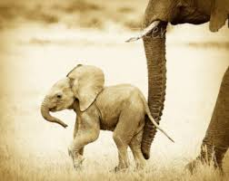
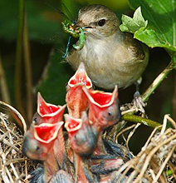
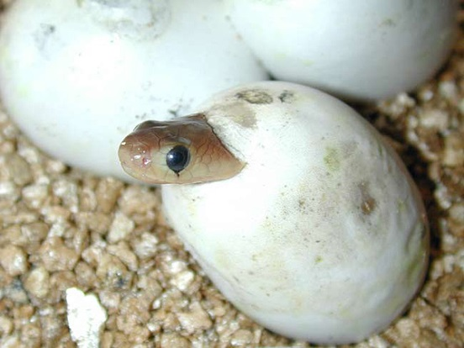
Fertilization for a diploid offspring
Upon fertilization, a “N” sperm meets a “N” egg and a zygote (2N) is formed.
1 N sperm
1 N egg
2N zygote

Slide 19
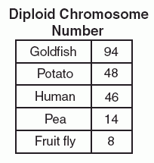
What are chromosomes?
Humans have 23 pairs (2n=46) of chromosomes, with one chromosome from each parent. The chromosomes are coiled up DNA.
Under normal conditions all of the chromosomes are inherited intact and in pairs.
This is a normal karyotype of human chromosomes. A karyotype is a picture of chromosomes lined up to look at and compare.

Slide 20
4 Chromosomal Disorders
Deletion: when cells go through meiosis, portions of the chromosome are lost.
Inversion: when cells go through meiosis, parts of the chromosome are flipped.
Translocation: when cells go through meiosis, parts of the chromosomes stick together and switch.
Non-disjunction: when cells go through meiosis the chromosomes don’t separate correctly and either too many or not enough are passed on.

Slide 21
Down Syndrome: Trisomy
Down Syndrome
1 in 31,000 births 46 chromosomes
XY=97% XX=3%
#14/21 Translocation
90-95% of Downs cases
1 in 1,250 births
47 chromosomes XY or XX
#21 Trisomy Non-disjunction

Slide 22
Down Syndrome
Short, broad hands
Stubby fingers
Rough skin
Impotency in males
Mentally retarded
Small round face
Protruding tongue
Short lifespan

Slide 23
Non-disjunction:
Turners Syndrome
1 in 5,000 births
45 chromosomes X only
#23 Monosomy Nondisjunction
Symptoms:
96-98% do not survive to birth
No menstruation (sterile)
No breast development
Narrow hips
Broad shoulders and neck

Slide 24
Klinefelter Syndrome
1 in 1,100 births
47 chromosomes XXY only
#23 Trisomy Nondisjunction
Scarce beard
Longer fingers and arms
Sterile
Delicate skin
Low mental ability
Normal lifespan

Slide 25
Deletion:
Cri-Du-Chat Syndrome
1 in 216,000 births
46 chromosomes
#5 Deletion of lower arm
Symptoms:
Moon-shaped face
Heart disease
Mentally retarded
Malformed larynx
Normal lifespan

Slide 26
Deletion: Aniridia-Wilms Tumor Syndrome
1 in 50,000,000 births
46 chromosomes XY or XX
#11 Deletion of upper arm
Symptoms:
Mentally retarded
Growth retarded
Blindness
Tumors on kidneys
Short lifespan

Slide 27
Thirteen Q Deletion Syndrome
1 in 500,000 births
46 chromosomes XY or XX
#13 Deletion of lower arm
Mentally retarded
Deformed face
No thumbs
Heart disease
Short lifespan

Slide 28
Deletion: Prader-Willi Syndrome
1 in 5,000,000 births 46 chromosomes
XY=97% XX=3%
#15 Deletion of lower arm
Small bird-like head
Mentally retarded
Respiratory problems
Obesity
Short lifespan

Slide 29
Eighteen Q Deletion Syndrome
1 in 10,000,000 births
46 chromosomes XY or XX
#18 Deletion of lower arm
Mentally retarded
Heart disease
Abnormal hands and feet
Large eyes
Large ears
Normal lifespan

Slide 31
Single Chromosome Disorders
Deletion
Genetic material is missing
2. Duplication
Genetic material is present twice
3. Inversion
Genetic material is “flipped”

Slide 32
Two Chromosome Disorders (Both types are called “translocation”)
Insertion
Genetic material is added from another chromosome
Translocation
Material is swapped with another chromosome

Slide 33
Translocation: Burkitt Lymphoma
Translocation of the Myc gene on chromosome 8
Normal Myc genes control cell growth and division
Translocated Myc genes don’t function properly
Leads to cancer of the lymph nodes

Slide 34
Cat-Eye Syndrome
1 in 1,000,000 births
46 chromosomes XY or XX
#22 Deletion of bottom arm
Fused fingers and toes
Mentally retarded
Small jaw
Heart problems
Normal lifespan

Slide 35
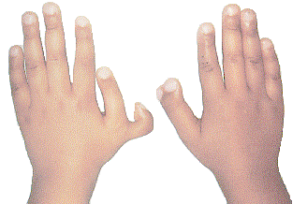
Patau’s Trisomy Syndrome
1 in 14,000 births
47 chromosomes XY or XX
#13 Trisomy Nondisjunction
Small head
Small or missing eyes
Heart defects
Extra fingers
Abnormal genitalia
Mentally retarded
Cleft palate
Most die a few weeks after birth

Slide 36
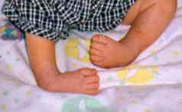
Four-Ring Syndrome
1 in 10,000,000 births
46 chromosomes XY or XX
#4 Inversion
Cleft palate
Club feet
Testes don’t descend
Short lifespan

Slide 37
Jacob’s Syndrome
1 in 1,800 births
47 chromosomes XYY only
#23 Trisomy Nondisjunction
?
Normal physically Normal mentally
Increase in testosterone
More aggressive
Normal lifespan

Slide 38
Triple X Syndrome
Normal physically
Sometimes taller
Normal mentally
Inc. risk of retardation
Fertile

Slide 39
Other Types of Inherited Genetic Disorder…

Slide 40
Tay-Sachs
Multiple kinds of mutation on Chromosome 15

Slide 41
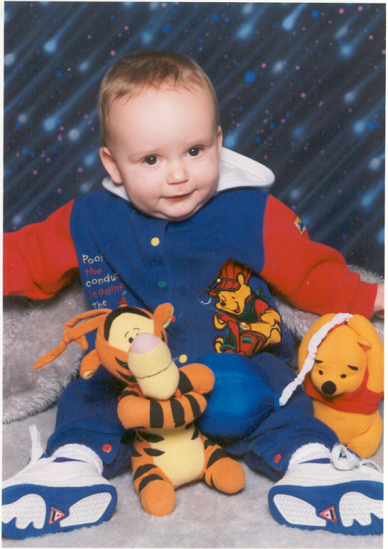
Tay-Sachs
incidence rate of infantile Tay-Sachs=
Ashkenazi Jewish groups, French Canadian & Cajun: 1 in 30 are carriers
other groups: 1 in 300 are carriers
accumulation of lipids on brain
brain malfunction; death by age 5

Slide 42
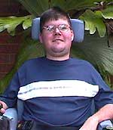
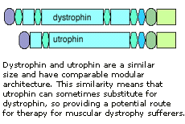
Sex-linked: X chromosome
Duchenne Muscular Dystrophy
1 boy in every 3,000
progressive weakening of muscles and loss of coordination
more common in males

Slide 43
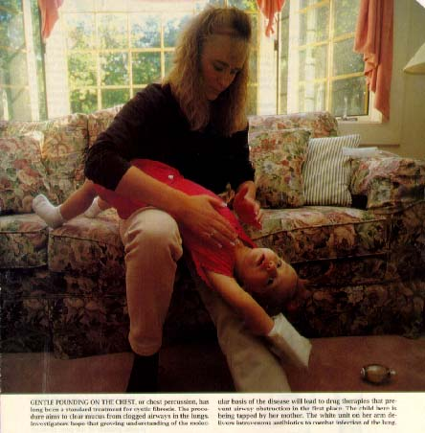
Cystic Fibrosis
1 in 31 is carrier in U.S.
Single gene mutation
mucus in lungs, pancreas, digestive tract and other organs
most common lethal genetic disease in U.S.
heterozygote may be resistant to typhoid fever

Slide 44
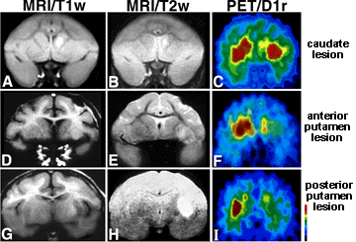
Autosomal Dominant
Huntington’s
incidence: 1/10,000 in U.S.
nervous system degenerates
late onset
may not show symptoms until past reproductive age

Slide 45
Karyotype Lab “Quiz” Tomorrow
Karyotyping for a disease
Partners
4 diseases represented, pick 2 karyotypes, cut and match. Once matched up, answer the questions about your two karyotypes.

