Slide 1
Friday Warm-Up (minimum 5 sentences)
If you could get your DNA sequenced (read) in a lab, would you want to know or NOT want to know about any diseases that you might develop later in life? Why or why not?
What about even though scientists might not be able to cure it yet? Explain your reasoning.
Fill out the last two boxes and turn in your warm-up

Slide 2
What is DNA? 2 facts
2

Slide 3
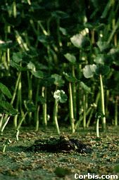
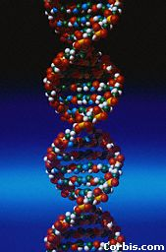
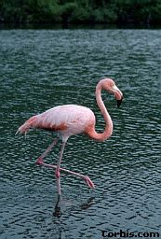
The Structure of DNA
EQ: What is DNA made of & why is it important?
3
Notes:
3
All life on earth uses a chemical called DNA to carry its genetic code or blueprint. In this lesson we be examining the structure of this unique molecule.
{Point out the alligator’s eyes in the first picture.} By the way, can you make out what this is?
***************************************************************
[The goal of this presentation is to introduce high school biology students to the chemical structure of DNA. It is meant to be presented in the classroom while accompanying the teacher’s lecture, under the control of the teacher.]

Slide 4
What year do you think DNA was first discovered?

Slide 7
DNA
DNA is often called the blueprint of life.
In simple terms, DNA contains the instructions for making proteins within the cell.
7

Slide 8
Why do we study DNA?
We study DNA for many reasons:
Its central importance to all life on Earth
It leads to medical benefits such as cures for diseases
It helps us grow better food crops (farming).
8
Notes:
8
{Ask students where the chromosomes are in this picture. Or ask them where the DNA is. Remind them that the mitochondria also have DNA.}

Slide 9
Chromosomes and DNA
Our genes are on our chromosomes.
Chromosomes are made up of a chemical called DNA.
DNA is found in the nucleus of all eukaryotic cells.
9
Notes:
9
{Show students a model of the double helix. Explain what a spiral is and a helix is.}

Slide 10
Review: The Shape of the Molecule
DNA is a very long polymer (poly=many).
The basic shape is like a twisted ladder or zipper.
This is called a double helix.
10
Notes:
10
We will take apart the DNA molecule to see how it is put together.
First, we will look at one strand.

Slide 11
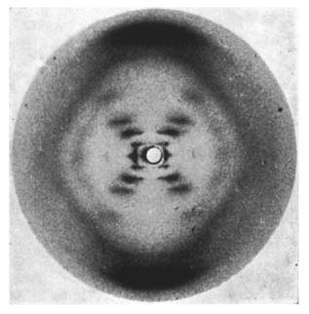
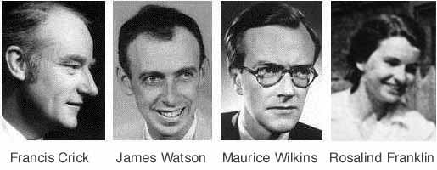
Discovered By
James Watson & Francis Crick won the Nobel Prize for figuring out that DNA was a double helix in 1953 using her photo but didn’t give her credit.
Rosalind Franklin took the famous “photo 51” x-ray they needed. It showed the twisted structure of DNA in 1952, she got cancer & died shortly after.

Slide 12
Was it fair? Justified for “science”?

Slide 13
Think-Pair-Share
In your pairs, if you’re on the left:
Give 2 reasons why it was justified or at least benefits science that Watson and Crick took Rosalind’s photo.
In your pairs, if you’re on the right:
Give 2 reasons why it was wrong that they took Rosalind’s photo and what they could have done better.

Slide 14
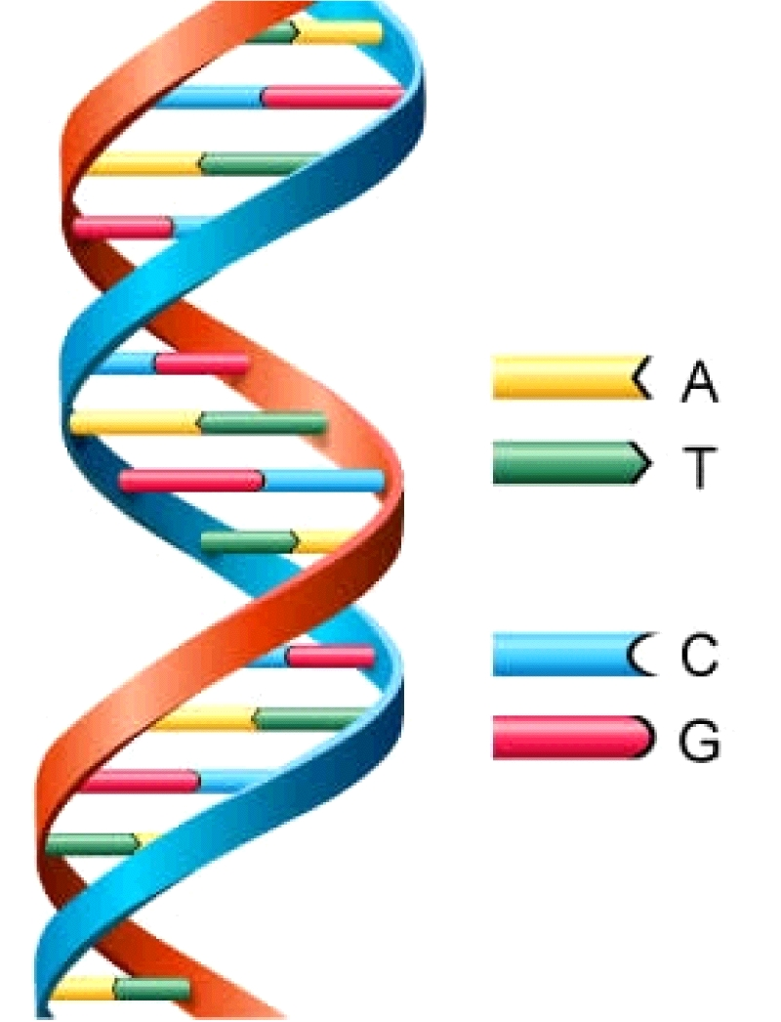
DNA Model
DNA is made of 4 different nitrogen bases that are put in a different order to make different genes:
Adenine
Thymine
Guanine
Cytosine
14
Notes:
14
{Point to the 3-D mode, if you have one, to show the parts as you discuss them.}

Slide 15
Let’s Practice!
Call out the answers!
15

Slide 16
What does G stand for?
Guanine!
16

Slide 17
What does A stand for?
Adenine!
17

Slide 18
What does T stand for?
Thymine!
18

Slide 19
What does C stand for?
Cytosine!
19

Slide 20
One Strand of DNA
The backbone of the molecule is alternating phosphates and deoxyribose sugar
The teeth are nitrogenous bases.
1 of each= a nucleotide
phosphate
Deoxyribose
sugar
bases
20
Notes:
20
These four bases are abbreviated by using their respective first letters.

Slide 21
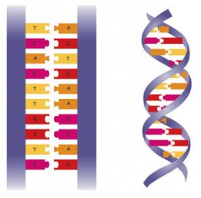
Two Stranded DNA
Remember, DNA has two strands that fit together something like a zipper.
The teeth are the nitrogenous bases but how do they stick together?
21
Notes:
21

Slide 22
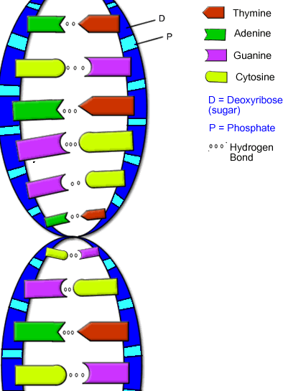
Hydrogen Bonds
The bases stick to each other because of hydrogen bonds.
Hydrogen bonds are weak but there are millions and millions of them in a single molecule of DNA.
22
Notes:
22
p1

Slide 23
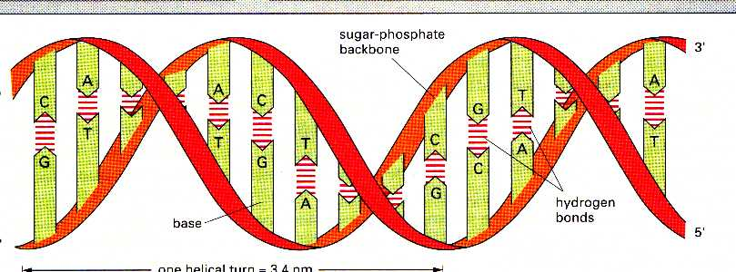
Hydrogen Bonds, cont.
When making hydrogen bonds in DNA:
cytosine always pairs up with guanine
Adenine always pairs up with thymine
23

Slide 24
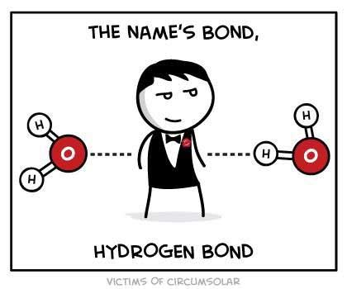
Chargraff’s Rule:
Adenine and Thymine always join together
A T
Cytosine and Guanine always join together
C G
If you have 20,000 As in a DNA strand, then you know there should also be 20,000 Ts.
So, if you have 17,000 C’s, then you know there should also be 17,000 whats?
There will be a question like this next week!
24

Slide 25
A
T
C
G
T
A
C
G
A
T
G
C
T
A
Notes:
25
{Point to the 3-D mode, if you have one, to show the parts as you discuss them.}

Slide 26
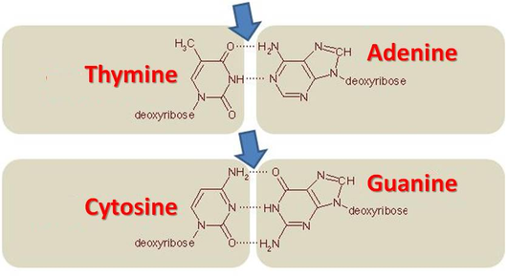
Hydrogen bonds: A&T, C&G
26

Slide 27
Base Pairs: Let’s Practice!
27

Slide 28
Practice: DNA Base Pairing
Which Nitrogen base pairs with:
Adenine
Thymine
28

Slide 29
Practice: DNA Base Pairing
Which Nitrogen base pairs with:
Guanine
Cytosine
29

Slide 30
Practice: DNA Base Pairing
Which Nitrogen base pairs with:
Thymine
Adenine
30

Slide 31
Practice: DNA Base Pairing
Which Nitrogen base pairs with:
Cytosine
Guanine
31

Slide 32
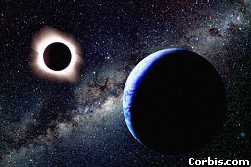
DNA by the Numbers
Each cell has about 2m of DNA…
…The average human has 75 trillion cells.
=The average human has enough DNA to go from the earth to the sun more than 400 times.
DNA has a diameter of only 0.000000002m- that’s how it fits in a tiny cell!
The earth is 150 billion m
or 93 million miles from
the sun.
32
Notes:
32
About better food crops, this area is controversial. There is a Dr. Charles Arntzen who is working on bioengineering foods with vaccines in them. People in poor countries could be immunized against diseases just by eating a banana, for instance.

Slide 33
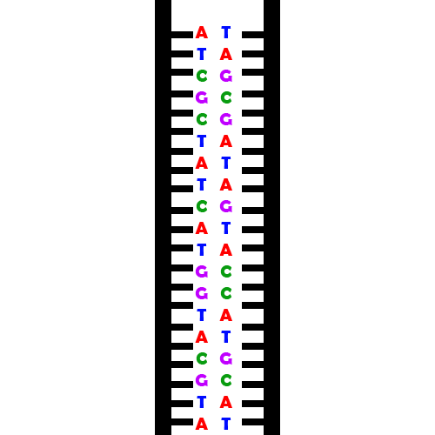
DNA Replication during Mitosis & Meiosis:
When the cell wants to divide it has to copy its insides first, including its DNA.
You’d first need a template or instruction to replicate DNA…
So the cell “unzips” the DNA in two separate strands. Now you have two templates the cell can read and copy.
Turns 1 strand of DNA into 2 identical strands
33

Slide 34
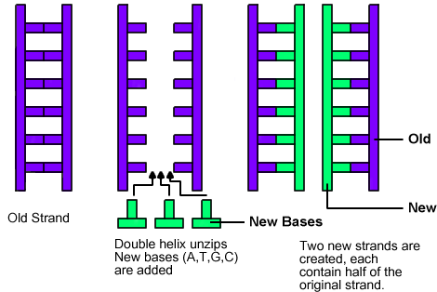
DNA Replication
When the enzyme has passed the end of the DNA, two identical molecules of DNA are left behind. Each contains one old side of the original DNA and one side made of "new" bases.
34

Slide 35
Errors “Mutations” occur during replication
It is possible that mistakes were made along the way -- in other words, that a base pair in one DNA molecule doesn't match the corresponding pair in the other molecule. On average, one mistake may exist in every billion base pairs.
That's the same as typing out the entire Encyclopedia Britannica five times and typing in a wrong letter only once!
35

Slide 36
DNA Structure
If A’s always pair with T & Cs with Gs, you can tell what the other half of the DNA strand will be even after it is split apart:
A G G - C T C - A A G - T C C - T A G
T C C - G A G - T T C - A G G - A T C

Slide 37
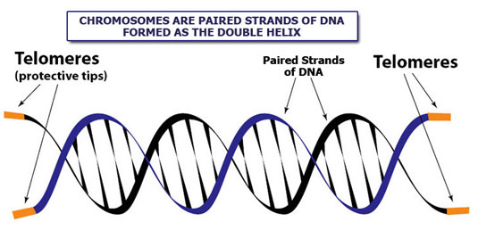
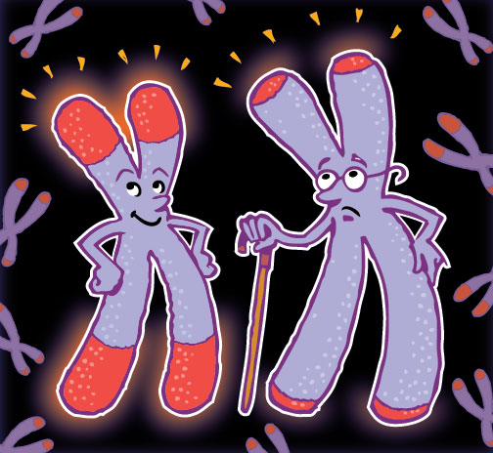
DNA & Aging
Telomeres are the ends of our chromosomes/DNA
Every time our chromosomes are copied, a little bit gets cut off the end.
As we get older our cells have divided more and more, so our telomeres are getting shorter and shorter. Until…
Once the telomeres are gone, bits of important DNA get cut off and the cell dies...this why why we can’t live forever ☹
37

Slide 38
DNA Structure
A gene is a section of DNA that codes for a protein.
Each unique gene has a unique sequence of bases.
This unique sequence of bases will code for the production of a unique protein.
It is these proteins and combination of proteins that give us a unique phenotype.
Notes:
38

Slide 39
What is a Gene? 2 facts pg. 74
39

Slide 40
Honors Video: Amoeba Sisters
40

Slide 41
What do you think?
DNA Drama: Was it justified? Was there another way?
Was it fair for Wilkins to share Rosalind’s Photo 51 with the other team?
Exit Ticket

Slide 42
DNA Replication Practice WS pg. 75
half-sheet
42

Slide 44
Tuesday
44

Slide 45
DNA
Gene
Protein
Trait
Notes:
45

Slide 46
Shorter telomeres have been associated with increased incidence of diseases and poor survival.
The rate of telomere shortening can be either increased or decreased by specific lifestyle factors.
46

Slide 47
47
Notes:
47

Slide 48
DNA-RNA-protein Video
48

Slide 49
Have your DNA and eat it, too! Lab
Make a DNA model
49

